Slide 1

Pattern Patent
ETL
Notes:
# only scratched the surface of the data for the limited time and resources

Slide 2
Previously on Pattern Patent …
Would you afford the time cost?
Check out Hamlet App
Is your case likely to be patented?
Check out Hamlet App
Which attorney are you talking to?
Check out HesJustNotThatIntoYou App
Would you want to live around other inventors?
If yes, move to CA, Ivy Leauge, RTP areas
Do you know the examiner’s sweet spot?
25, 135, 837 rules
Notes:
Would you like to give an overview of patents?

Slide 3
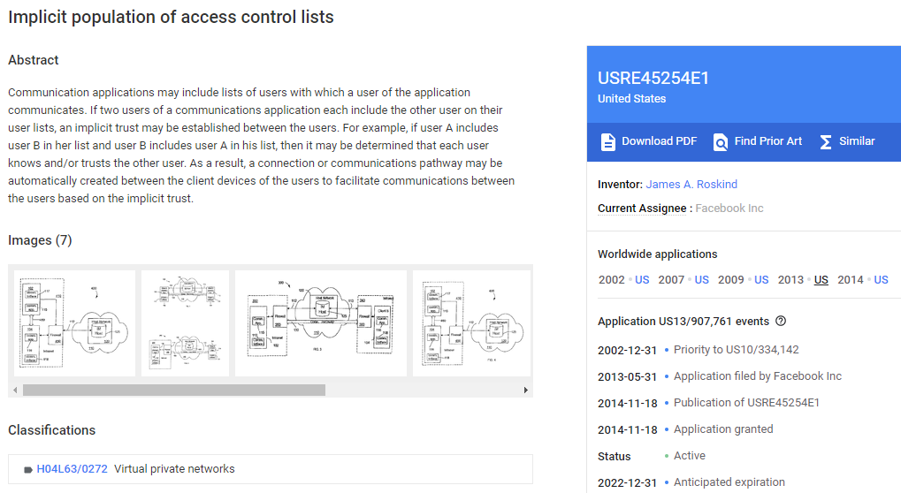
https://patents.google.com/patent/USRE45254

Slide 4
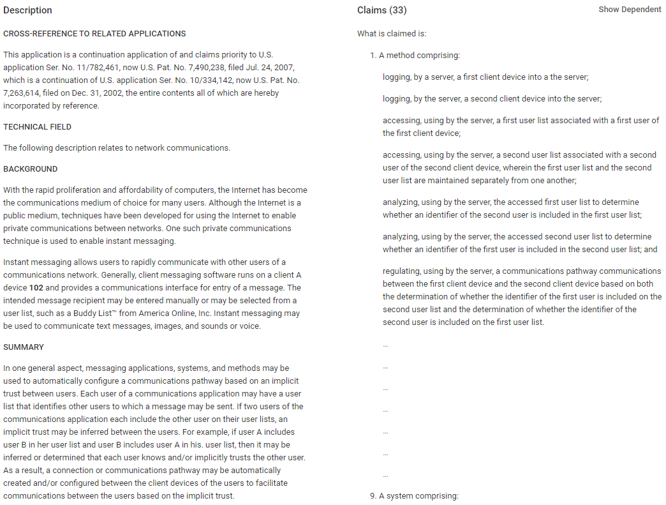
https://patents.google.com/patent/USRE45254

Slide 5
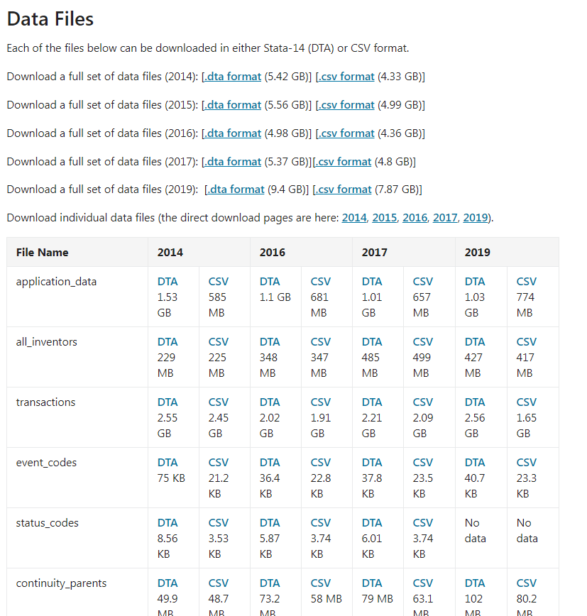
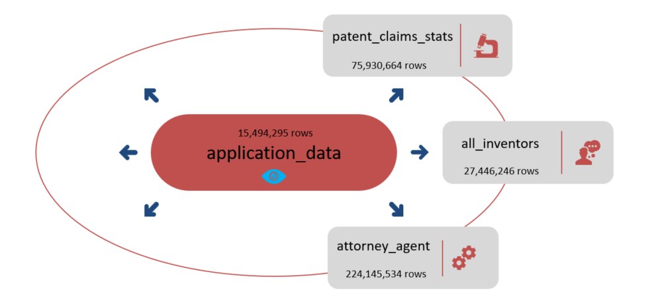
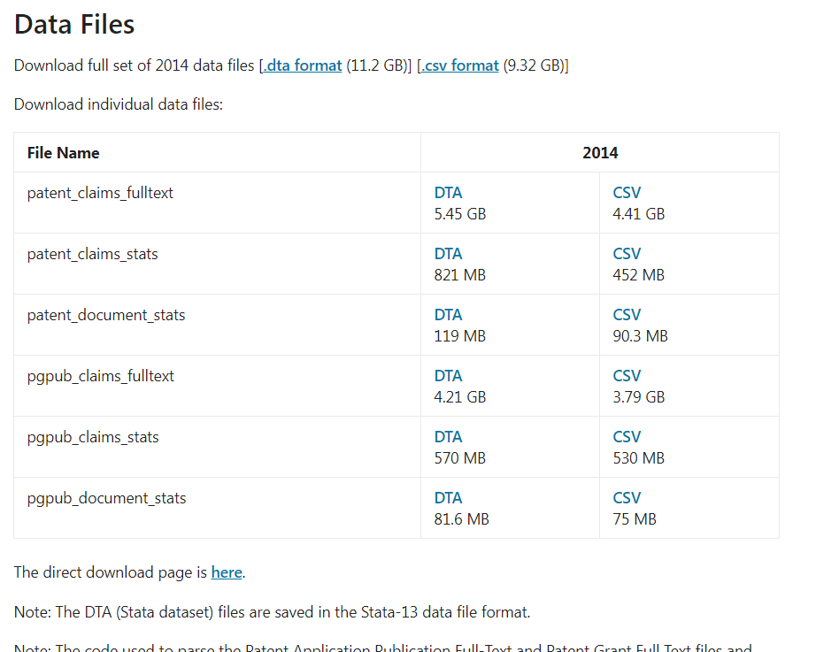
Extract
Data Source
https://www.uspto.gov/learning-and-resources/electronic-data-products/patent-examination-research-dataset-public-pair
https://www.uspto.gov/learning-and-resources/electronic-data-products/patent-claims-research-dataset

Slide 6
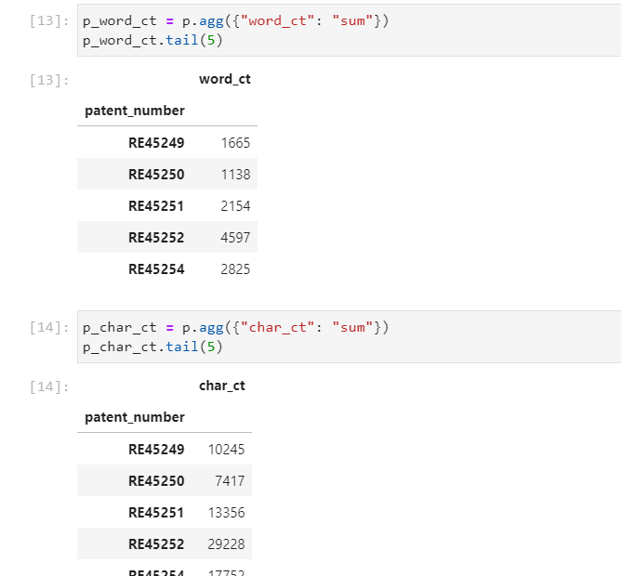
Transform
Data cleaning and transformation (cleaning, joining, filtering, grouping, merging, aggregating, etc) are performed in Python

Slide 7
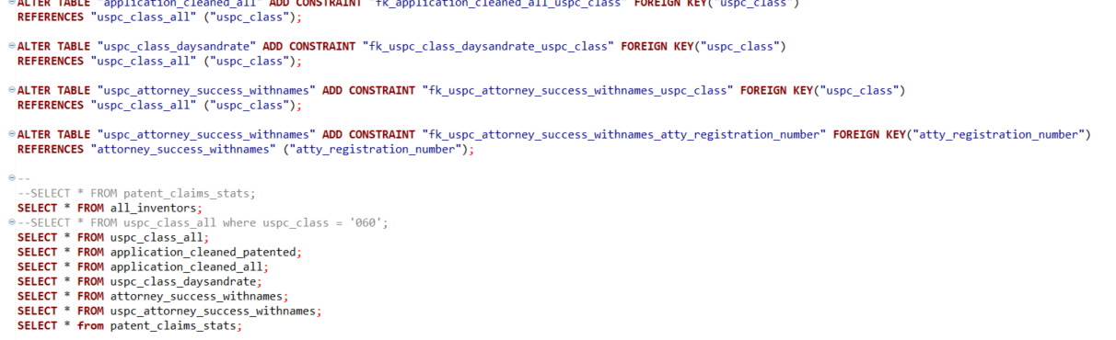
Load
PostgreSQL/Beaver

Slide 8
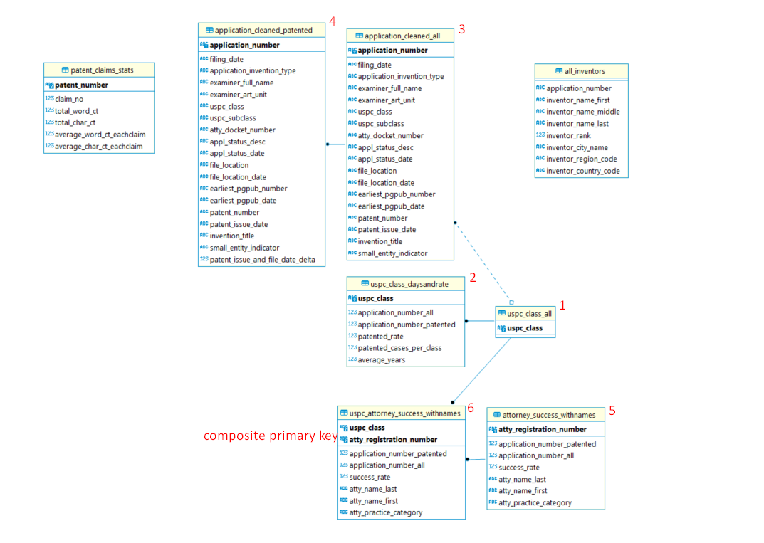
Load

Slide 9
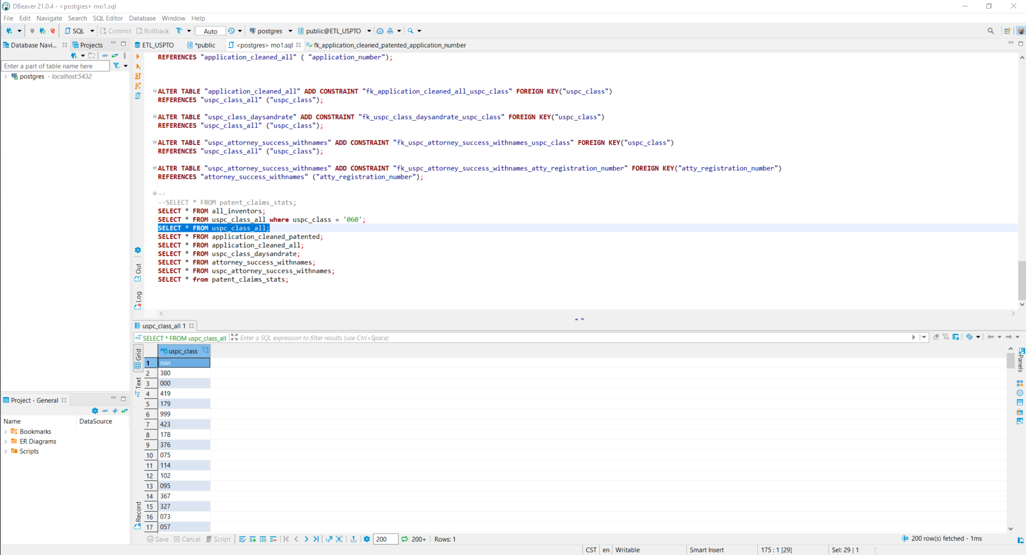
Load

Slide 10
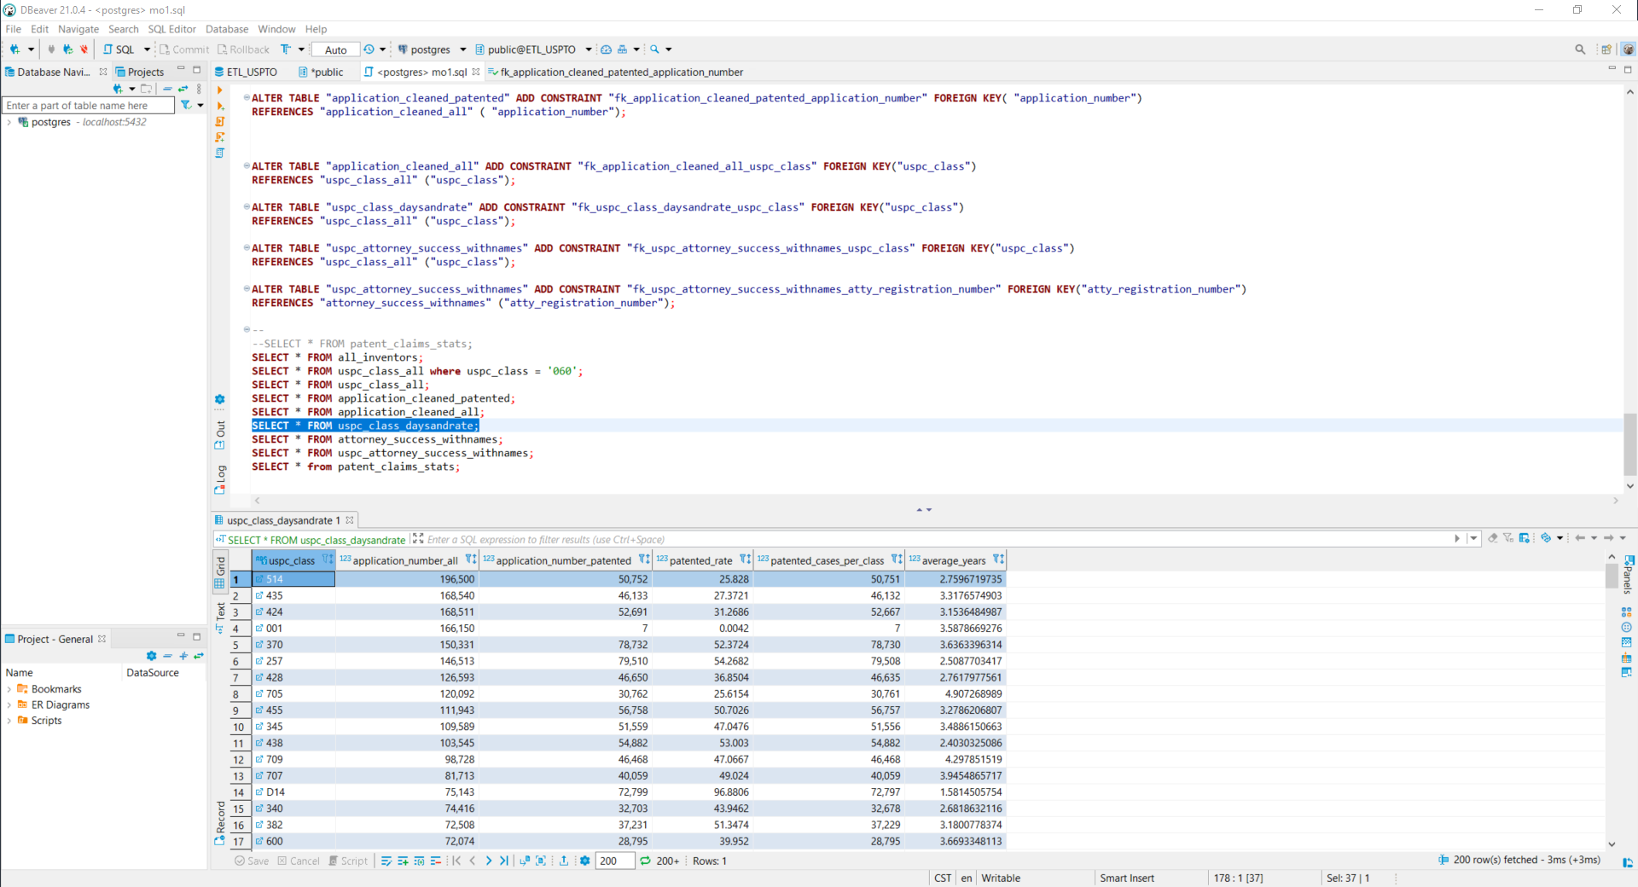
Load

Slide 11
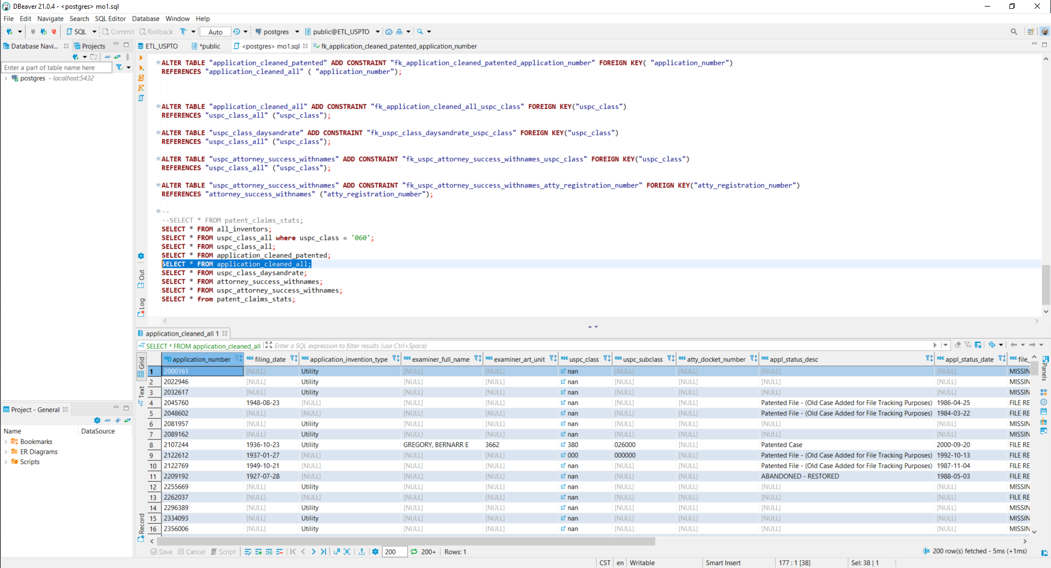
Load

Slide 12
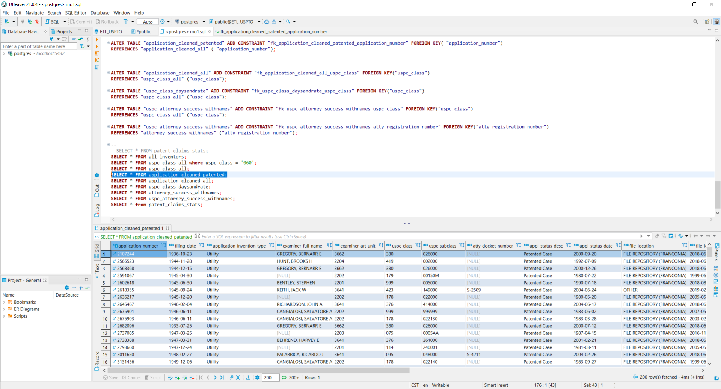
Load

Slide 13
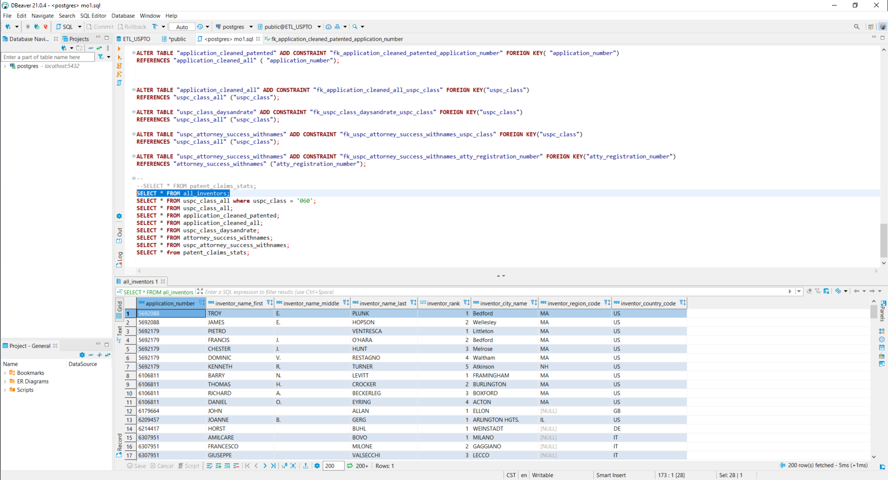
Load

Slide 14
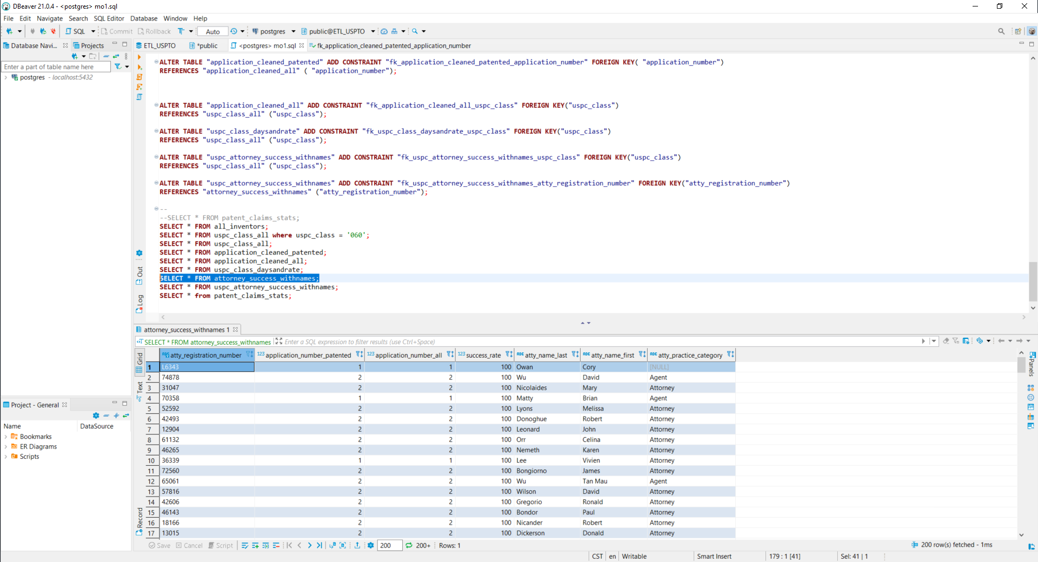
Load

Slide 15
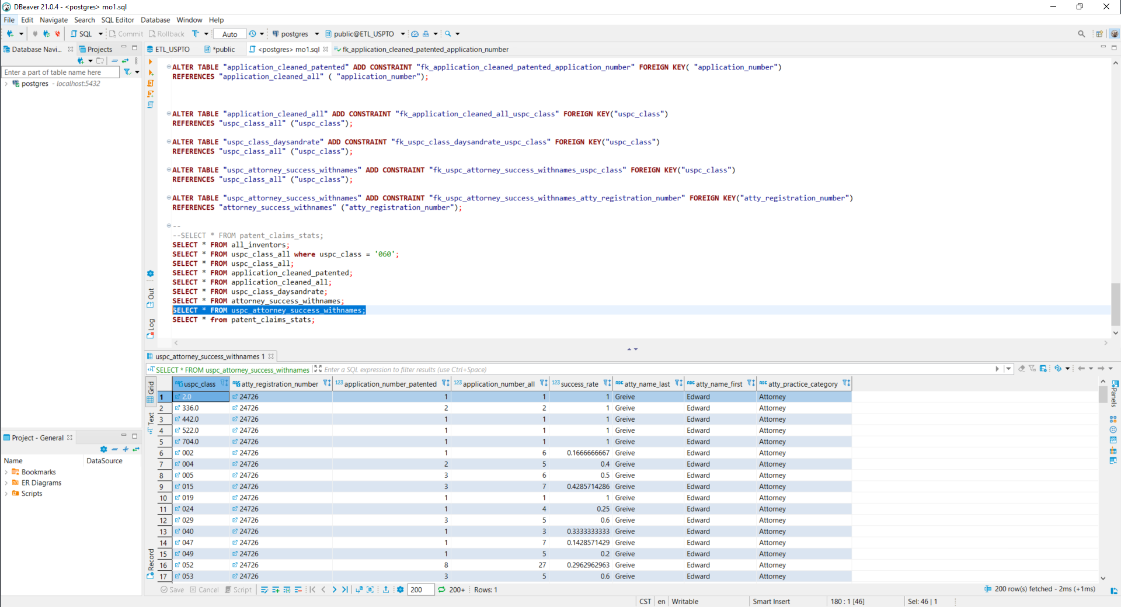
Load

Slide 16
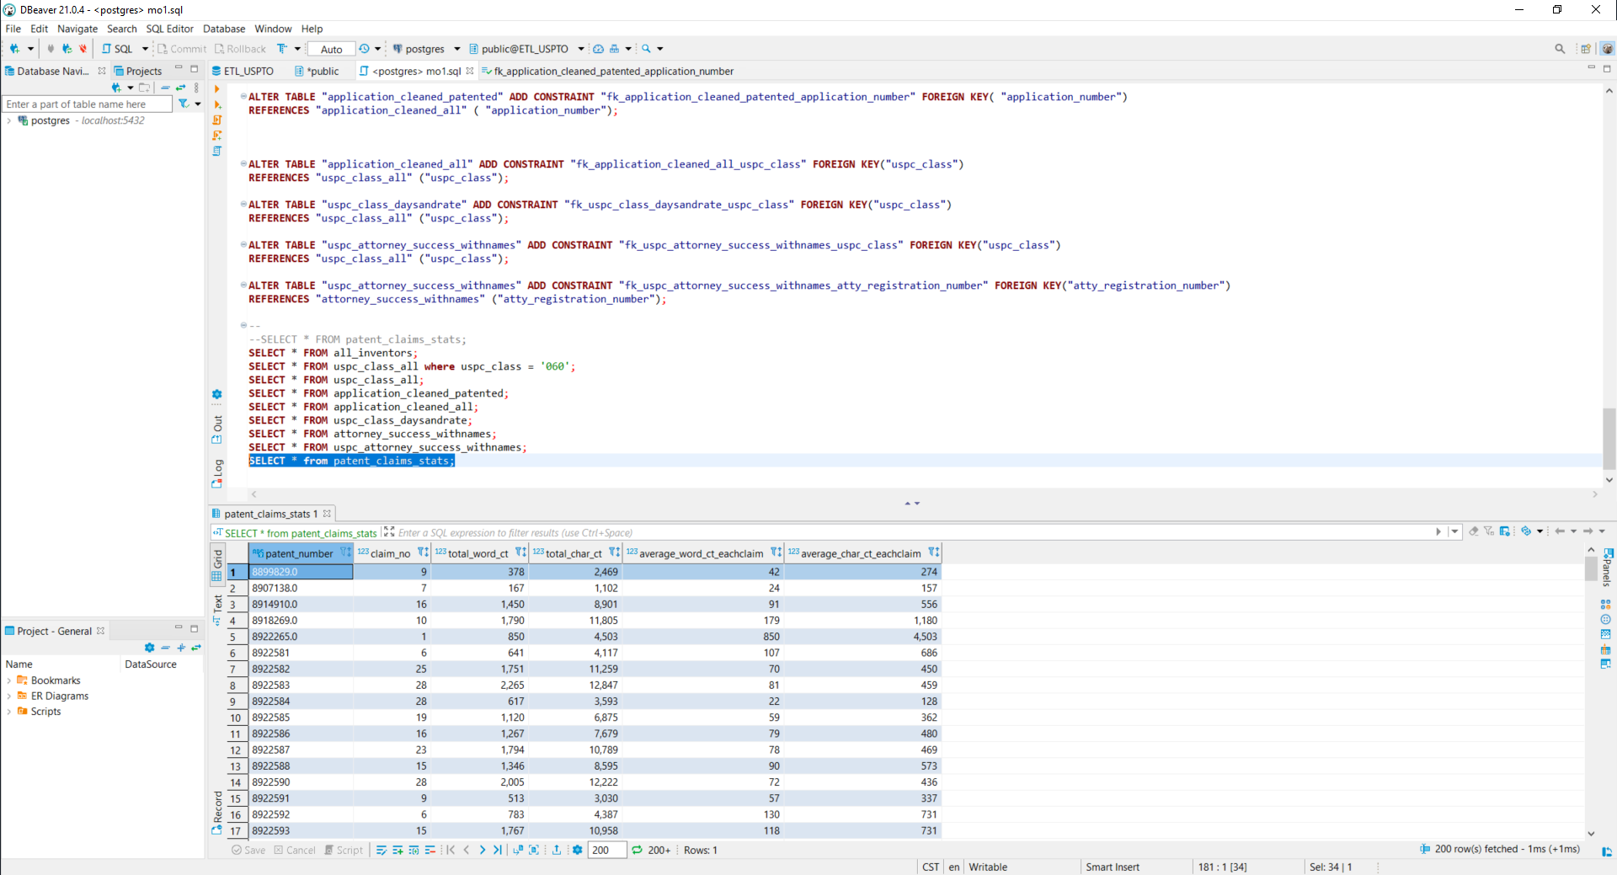
Load

Slide 17
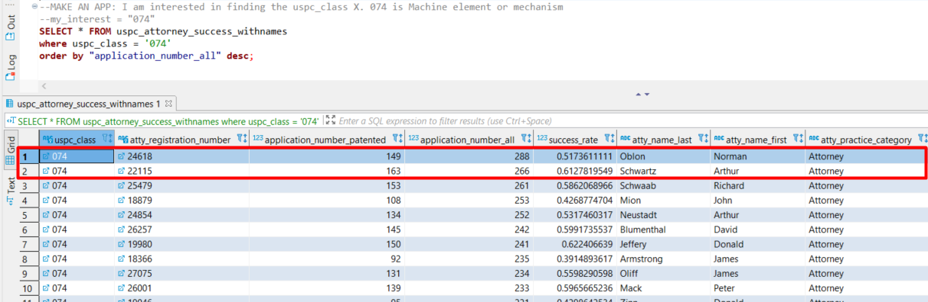
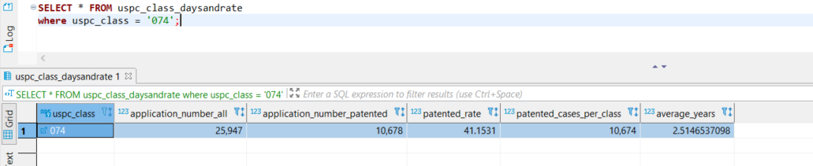
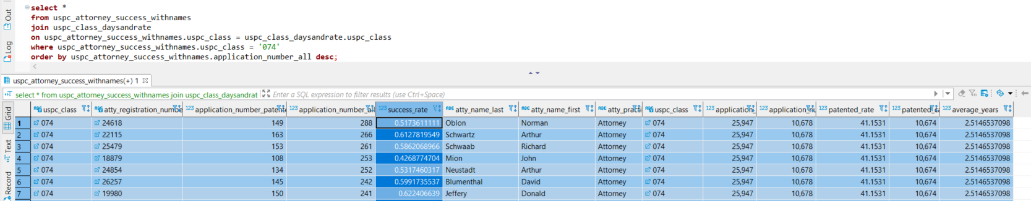
Load
HesJustNotThatIntoYou App
Hamlet App
Interstellar App
Notes:
I break down by classes and then check on attorney!

Slide 18
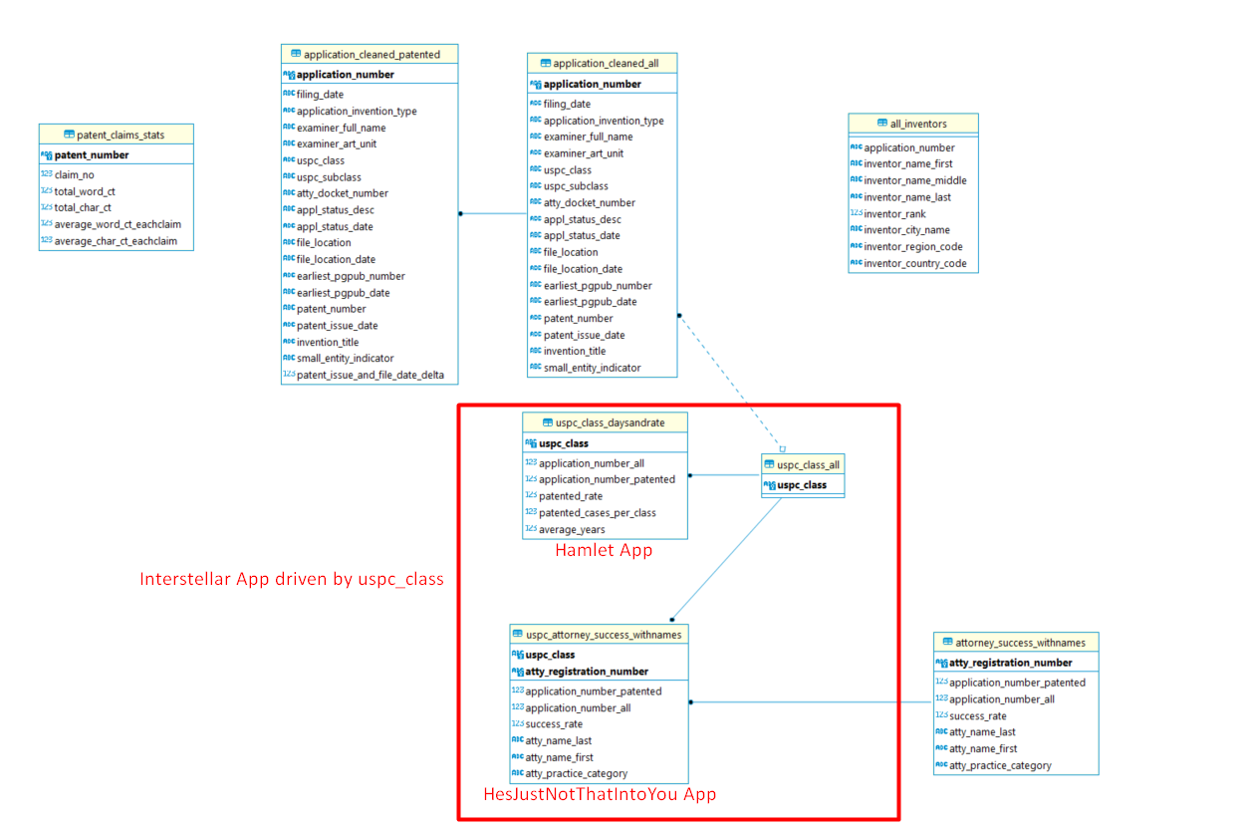
Load

Slide 19
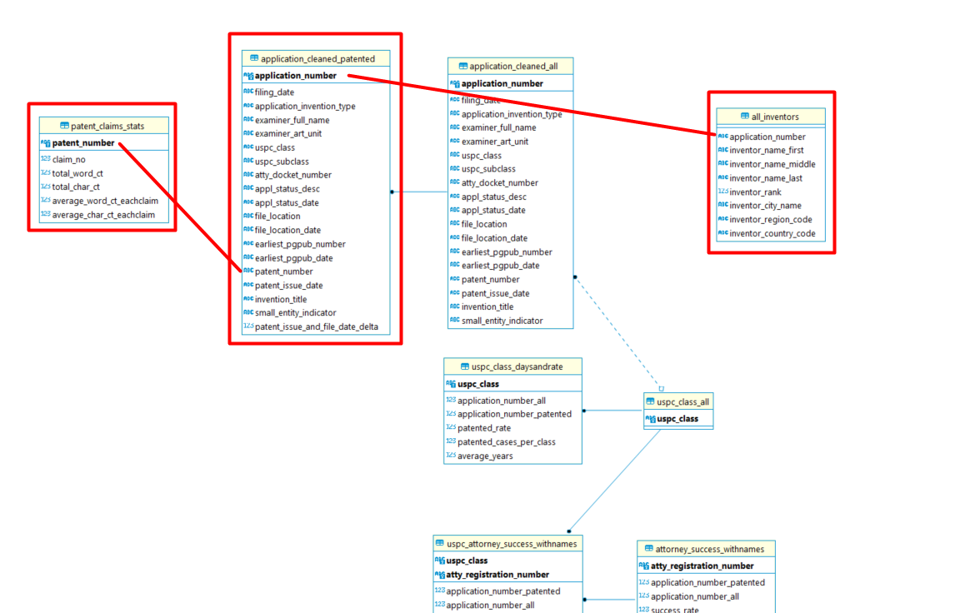
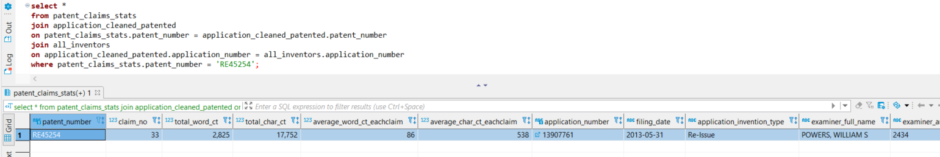
Load

Slide 20
Load
Version I

Slide 21
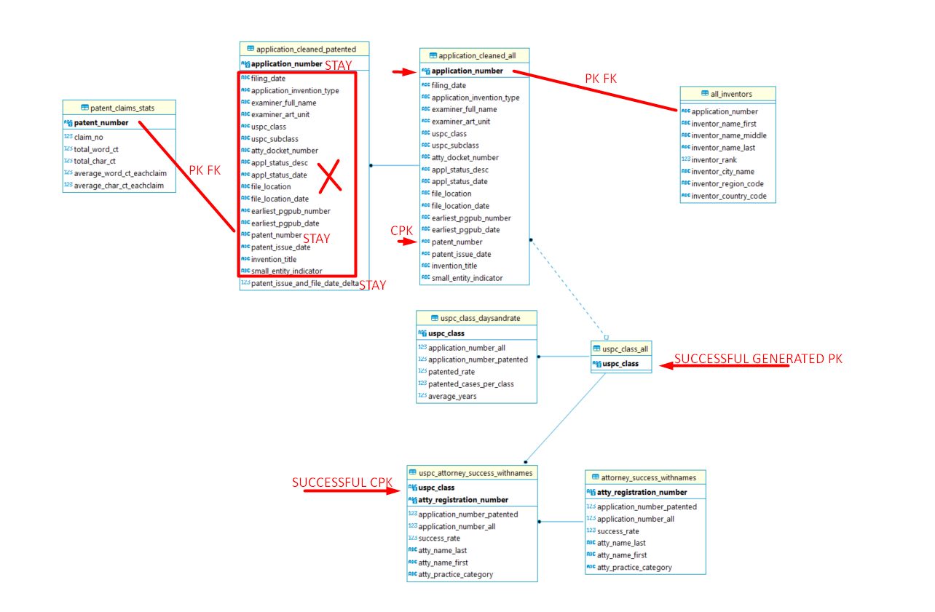
Load
Version II

Slide 22
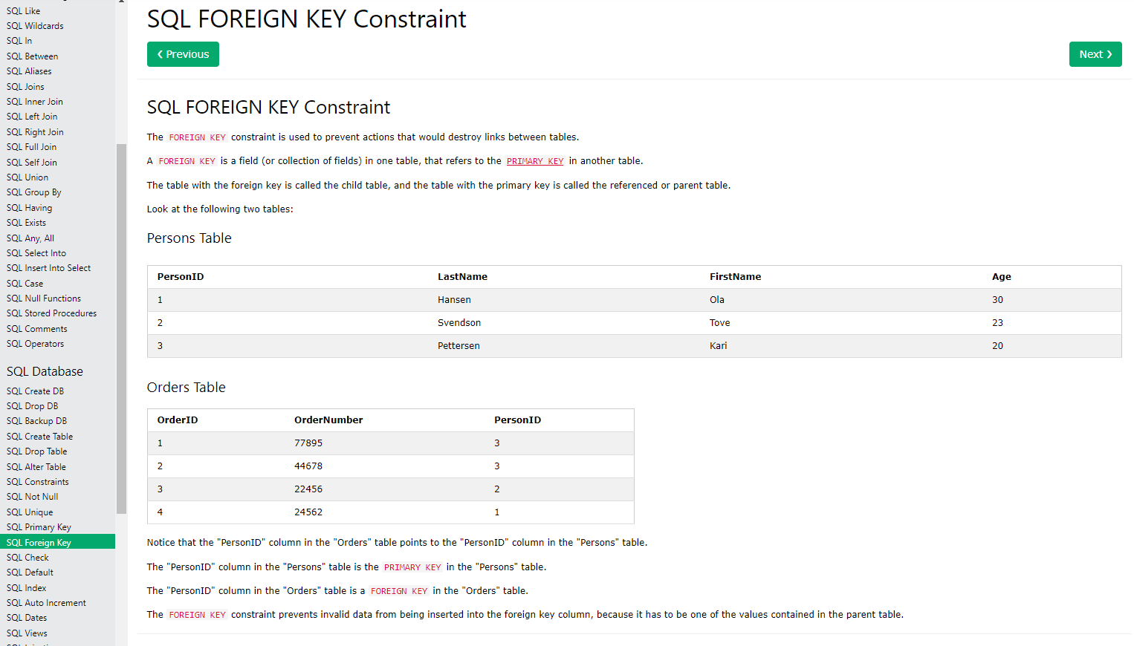
Load
Concept is Paramount
Notes:
Whole idea of database is to prevent you from entering data into the table which should not be there!!!
Insert a foreign key which does not exist in the primary table’s primary key: the foreign key was linked to the primary key !!!!!

Slide 23
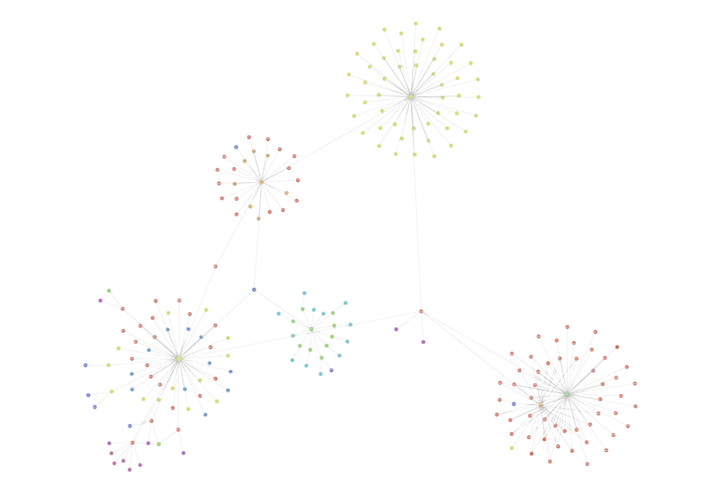
Load
Lessons to Learn for Next Step
Primary key has to be not null AND unique AND covers all the values in foreign key – generate a dataframe that covers all values of a column and use as PK. Probably requires outer join from all tables to cover all the unique values for a column. FK can contain null.
Composite primary key can not contain any null in any primary key column even if every row is unique. If really need to use every unique row as a primary key with a few null values in it, create an index to represent the rows and use as PK.
Null is a bad input, prefer 0 or 000000000 which helps to make CPK in my case. Drop duplicate rows in my case.
Better not to have duplicated columns in different tables.
In Python, when there are mixed types (mixed float, string, int) in one column, make sure to convert them to one data type string before unique()
Graph database
Bear the PostgreSQL schema rules in mind when Transforming in Python.

Slide 24
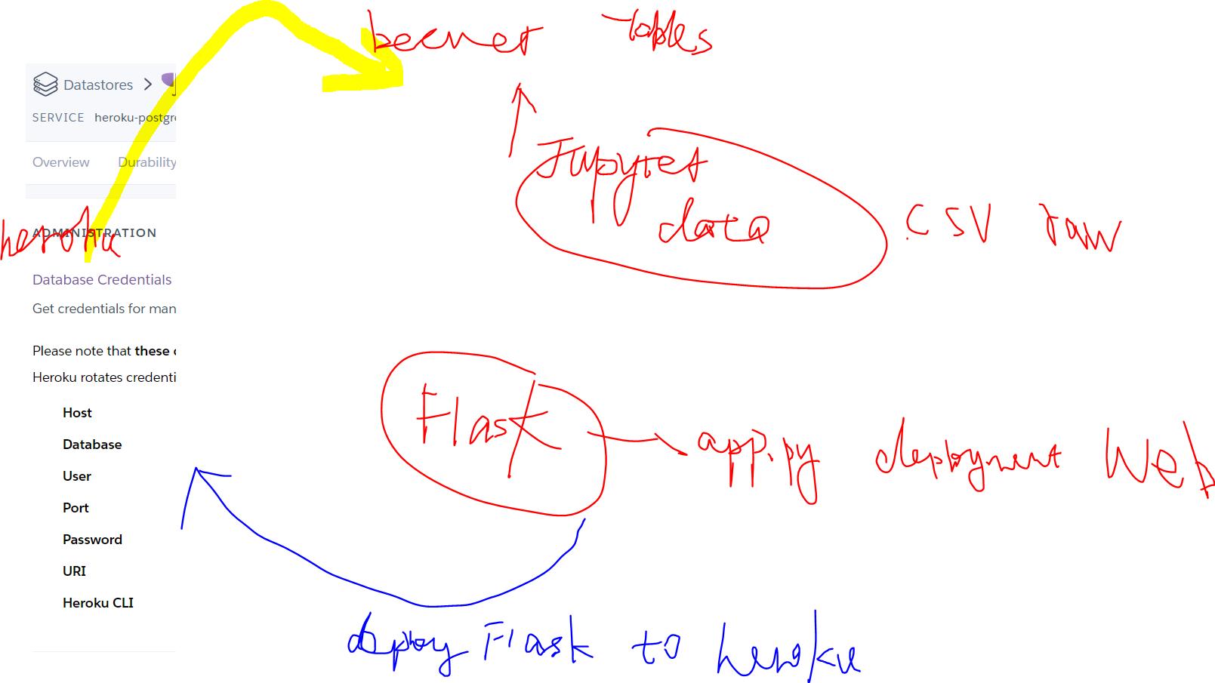
Deploy

Slide 25
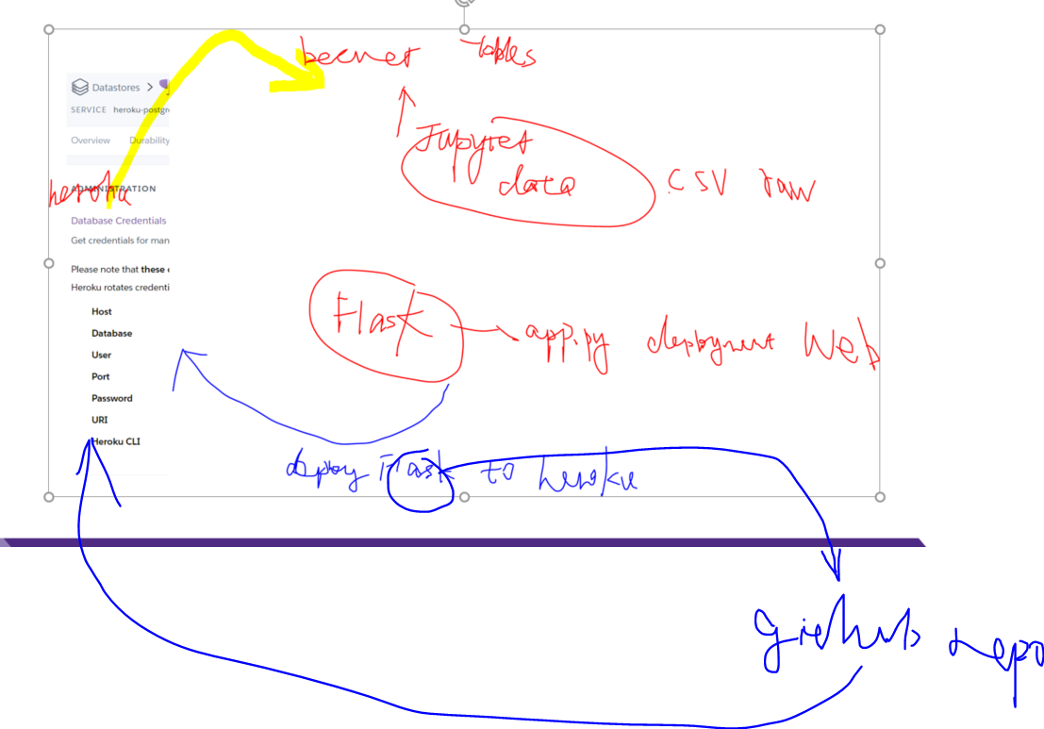
Deploy

Slide 26
Copyright and Trademark Notice
All material in this presentation, including design, text, images, charts, are owned by Liang Gong, protected by US copyright and trademark laws. All rights are reserved by Liang Gong. Content may not be copied, reproduced, transmitted, distributed, downloaded or transferred in any form or by any means without Liang Gong's prior written consent, and with express attribution to Liang Gong. The only exception is that one temporary copy may be downloaded into a single computer's memory and one unaltered permanent copy may be used by the viewer for personal and non-commercial use only, with an attached copy of Liang Gong 's written consent. No part of the downloaded copy may be subsequently reproduced, disseminated or transferred. Copyright infringement is a violation of federal law subject to criminal and civil penalties. (For permission to reprint, please contact Liang Gong via email at gongliangtju@gmail.com)

Slide 27
Thank You Teachers!

Slide 28
Questions?

